Slide 1
Extract Coverage Tool
CHS ATL
Michel Leger
Michel.leger@dfo-mpo.gc.ca

Slide 2
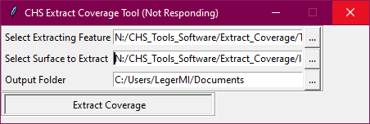
Quick Start
This Tool will create two csar surfaces, A Valid csar and a Suppressed csar based on a feature hob file (cutter).
Extracting Feature (Cookie Cutter) “.hob”
Surface to Extract
Valid(Blueline), and Suppressed saved to Surface Directory Surfaces. VALSRC#_BL.csar, VALSRC#_SUP.csar
Output Directory for wkt file

